Slide 1


Brain Tumor Segmentation & Classification
Dr. Hala Zayed
Eng. Nada Bahaa
Presented By
Mohamed Mohsen Fouad
Ahmed Samir Afifi

Slide 2
Content
Overview
Methodology
Steps Result
Final Result
Conclusion

Slide 3
Overview
Brain Cancer is an abnormal cell population that occurs in the brain, so in this Presentation we clarify methods to identify brain tumors in MRI Scans by using Image Processing techniques Specially in Python programming language by using Segmentation methods and then Classify these images to identify which image contain tumor or not, the proposed is segmented tumor region clear enough to classify and be observed by the medical practitioner and give them more detail about the tumor in their diagnosis.

Slide 4
Methodology
Input image
Gray Scale
Threshold
Morphological
Operation
Normal
Classification
Segmented
Image
Connected Components
analysis
Tumor

Slide 5
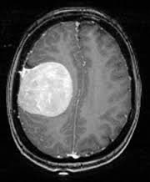
Steps of Processing (Read Dataset)
First We use some libraries in python for processing (OpenCV – MatPlotLib – Numpy - Pillow)
We use Brain Tumor MRI Scans Dataset from Kaggle, then we load the data with Numpy and Pillow to read all images as array to be able to perform different processing on image
Input Image

Slide 6
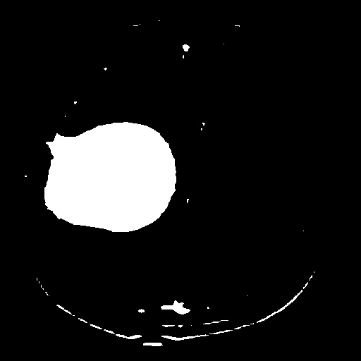
Steps of Processing (Gray Scale & Thresholding)
After reading dataset images we convert the images from RGB to Gray Scale because RGB shaped in 3 channels and Gray Scale images only 2 channels, so after we convert images to gray
scale we apply thresholding method to isolate the foreground which is the object from background which is Blacked.
Thresholding is covert image to binary Image White and black (0 ,1)
Binary Threshold
at 160
Gray Scale Image
Threshold Image

Slide 7

Steps of Processing (Morphological Operation)
A morphological operation is defined by moving an array called Structured Element on the image to be modified
There are Different Types of Morphological Operations such as: Dilation – Erosion – Opening – Closing, in our case we use Closing to remove small holes and opening to remove small holes.
Opening Process is applied on threshold image
Closing Operation is applied on Opening image
Opening
Closing
SE 7X7
SE 7X7
Threshold image
Opening Image
Closing Image

Slide 8

Steps of Processing (BLOB Analysis)
BLOB is stands for (Binary Large Object)
Blob Analysis it means detect connected regions in binary images so we can calculates statistics or centroid, bounding box, label matrix for labeled regions and number of blobs in image
We get labeled image after we get the statistics of the tumor area so we can isolate it only.
Labeled Image
Using 4 Connectivity
Closed Image
Labeled Image

Slide 9
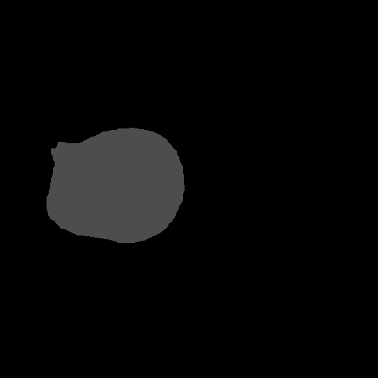
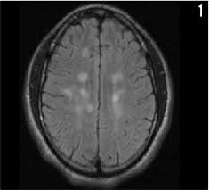

Steps of Processing (Classification)
After we applied blob analysis in all images data that contain Tumor and Not contain we can Classify our images into Classes First images with Tumor Second with No Tumor .
Classification is based on number of Blobs in image if image has more 1 blobs then it will be Classified as Tumor else it Classified as Normal.
By applying this method we can detect the tumor.
Segmentation
Classification
Tumor Founded
Segmentation
Classification
Normal

Slide 10
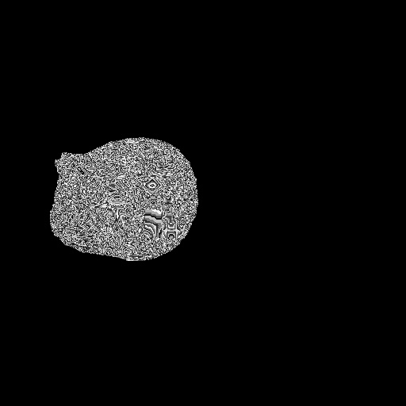
Final Result (Confusion Matrix)
Now we get the final result of segmentation of previous processes as shown in the figure this is the final image after convert it to gray level by multiplying it in original image we get the gray levels of the tumor.
Confusion Matrix
True Positive (TP): Existing tumor and detected correctly
True Negative (TN): Non-Existing tumor and Non-detected correctly
False Positive (FP): Non-existing tumor and detected
False Negative (FN): Existing tumor and not detected
Tumor
Non-Tumor
TP = 60 | FN = 28 | TN = 86 | FP = 0
Final Result

Slide 11
Final Result (Accuracy , Sensitivity, Specificity)
Accuracy : measure of successful classification
Specificity : measure of successful determination of the person not having a tumor
Sensitivity : measure of successful determination of the person having a tumor

Slide 12
Conclusion
In this study we clarify the methods to process medical images which include grayscale conversion, threshold binary image, morphological operation and blob analysis with MRI scans by using libraries in python we can make computers apply these operation automatically after MRI scan directly without help of humans, computers can apply these process fast and accurate.

Slide 13
Thanks!

